Slide 1
FY 2021 and FY 2022 Budget Update
July 20, 2021
Campus Forum

Slide 2
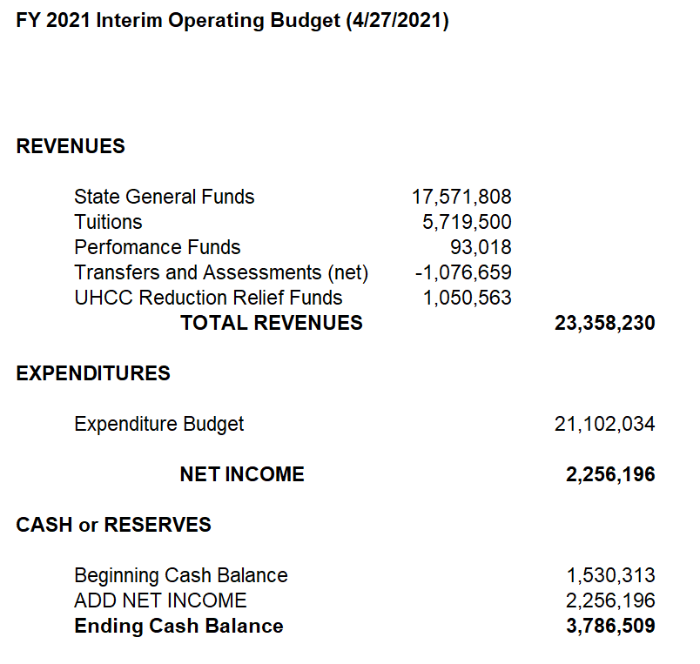

Slide 3
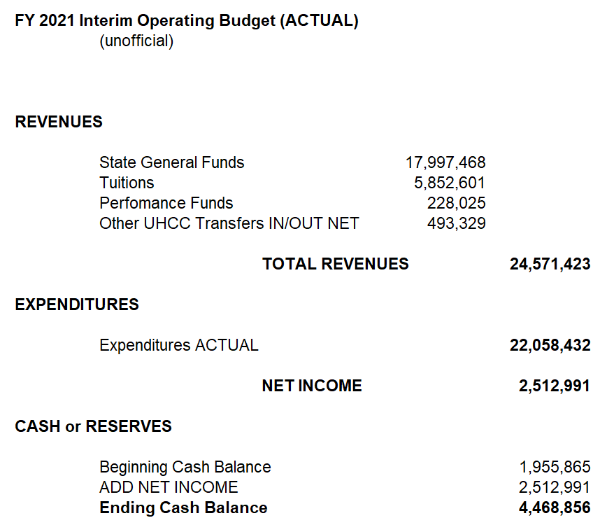

Slide 4
FY 2022 – INITIAL BUDGET ASSUMPTIONS
Unofficial
University of Hawaii absorbed a 10% general fund reduction.
Assuming UH prorates 9% general fund reduction to UHMC ($1,619,772).
Assuming 3% enrollment decline ($172,000).
FY 2021 stringent expenditure plan applied to FY 2022

Slide 5
FY 2021 Across the Board Reductions
Lecturer reduction 25%.
Overtime Overload 75%
Casuals 75%
Student Help 25%
Travel 100%
Utilities 20%.
Other expenses 25%

Slide 6
FY 2022 Operational Changes
Utility Costs: Foodservice will reopen, Maui Food Innovation Center will open and campus will have increased on-campus presence.
Inter-island travel
Sign language interpreters - $400K
Lecturer Reductions were not realistic. Restored credit lecturer budget 230K and apprenticeship lecturer budget 100K.

Slide 7
Vacant Positions – Funded
Janitor III – H. Beers
Title IX Coordinator – D. Brown
Building Maintenance Worker – Z. Siliato
Molokai Academic Specialist – C. Lima
Enrollment Management Specialist – NEW
Recruiter – NEW
Institutional Researcher – J. Pezolli
OM Mailroom – I. Latu

Slide 8
Vacant Positions – Unfunded
Instruction
ELWD
Faculty Accounting – D. Meyer
Faculty Culinary – C. Speere
Faculty Lahaina Ed – M. Wukelic
Faculty Business – D. Grooms
Faculty AH – D. Cohen
Faculty Haw’n Std – K. Raymond
Faculty ETRO – M. Hoffman
Faculty Haw’n Stud – P. Kai’anui
Office Ass’t – L. Kimura
Faculty – N. van der Lee
Faculty – K. Phelps
Administrative Services
OM Maintenance – K. Quinabo
Bus Ofc – P. Lau

Slide 9
Vacant Positions - Unfunded
Student Affairs
Administration
Fin Aid Specialist – T. Aveiro
Counselor – S. Hedani
Vice Chancellor – J. McKee
Dir of IT – M. Albert
Media Center
Media Specialist – R. Dela Cruz
This does not include the 28 positions that were swept during the 2020 Legislative session.

Slide 10
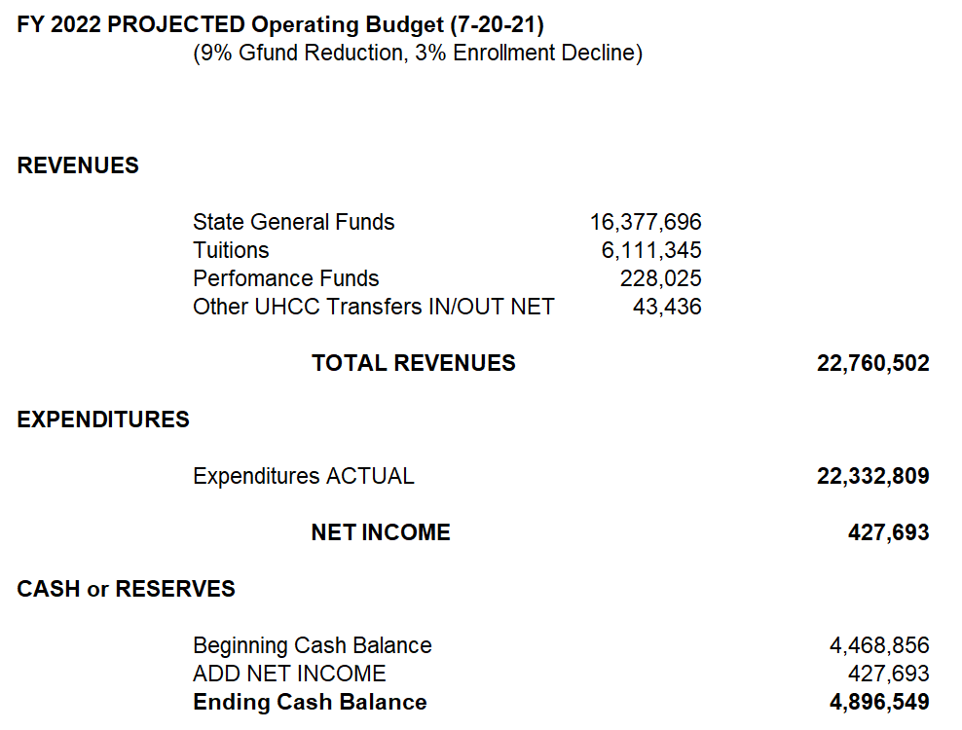
THESE ARE BROAD GROSS ESTIMATES
(Includes an infusion due to payment of student obligations)
Does not include HEERF funds – COVID Mitigation Funds

